Slide 1
Number Systems & Operations
Part II

Slide 2
Contents
Binary Arithmetic
Binary addition
Binary subtraction
Binary multiplication
Binary division

Slide 3
Basic Operations
Basic of binary arithmetic
Binary addition
Binary subtraction
Binary multiplication
Binary division

Slide 4
Contents
Binary Arithmetic
Binary addition
Binary subtraction
Binary multiplication
Binary division

Slide 5

FOUR (4) Basic Rules
The four basic rules for adding digits are as follows:
$0+0=0$ → sum of $0$ with a carry of $0$
$0+1=1$ → sum of $1$ with a carry of $0$
$1+0=1$ → sum of $1$ with a carry of $0$
$1+1=10$ → sum of $0$ with a carry of $1$

Slide 6
Example
Carry | 1 | 1
 |  | 1 | 1
 |  | 1 | 1
Sum | 1 | 1 | 0
Carry | 0 | 0
 | 1 | 0 | 0
 |  | 1 | 0
Sum | 1 | 1 | 0
Carry | 1 | 1 | 1
 |  | 1 | 1 | 1
 |  |  | 1 | 1
Sum | 1 | 0 | 1 | 0
Carry | 1 | 0 | 0
 |  | 1 | 1 | 0
 |  | 1 | 0 | 0
Sum | 1 | 0 | 1 | 0

Slide 7
Contents
Binary Arithmetic
Binary addition
Binary subtraction
Binary multiplication
Binary division

Slide 8

FOUR (4) Basic Rules
The four basic rules for subtracting digits are as follows:
$0−0=0$ → difference of $0$ with a borrow of $0$
$1−1=0$ → difference of $0$ with a borrow of $0$
$1−0=1$ → difference of $1$ with a borrow of $0$
$10−1=1 ;0−1$ → difference of $1$ with a borrow of $1$

Slide 9
Example
 | 1 | 1
 | 0 | 1
Borrow | 0
Difference | 1 | 0
 | 1 | 1
 | 1 | 0
Borrow | 0
Difference | 0 | 1
 | 1 | 0 | 1
 |  | 1 | 1
Borrow | 1 | 0
Difference | 0 | 1 | 0

Slide 10
Contents
Binary Arithmetic
Binary addition
Binary subtraction
Binary multiplication
Binary division

Slide 11
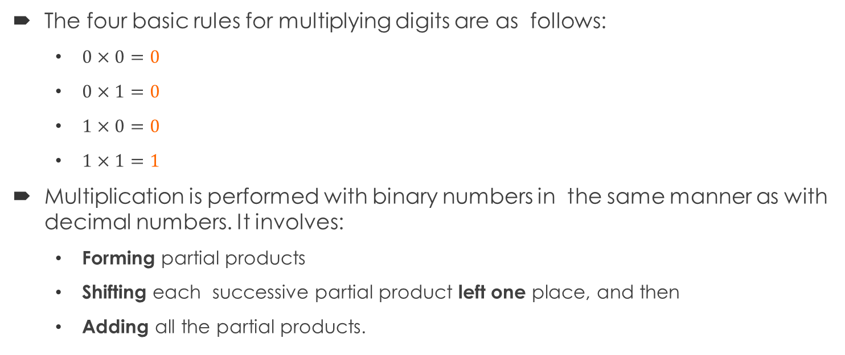
FOUR (4) Basic Rules
The four basic rules for multiplying digits are as follows:
$0×0=0$
$0×1=0$
$1×0=0$
$1×1=1$
Multiplication is performed with binary numbers in the same manner as with decimal numbers. It involves:
Forming partial products
Shifting each successive partial product left one place, and then
Adding all the partial products.

Slide 12
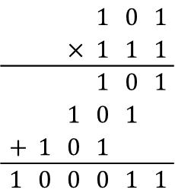
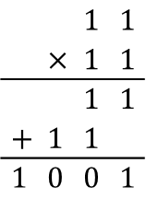
Example
 |  | $$1$$ | $$1$$
 | $$×$$ | $$1$$ | $$1$$
 |  | $$1$$ | $$1$$
$$+$$ | $$1$$ | $$1$$
$$1$$ | $$0$$ | $$0$$ | $$1$$
 |  |  | $$1$$ | $$0$$ | $$1$$
 |  | $$×$$ | $$1$$ | $$1$$ | $$1$$
 |  |  | $$1$$ | $$0$$ | $$1$$
 |  | $$1$$ | $$0$$ | $$1$$
$$+$$ | $$1$$ | $$0$$ | $$1$$
$$1$$ | $$0$$ | $$0$$ | $$0$$ | $$1$$ | $$1$$

Slide 13
Contents
Binary Arithmetic
Binary addition
Binary subtraction
Binary multiplication
Binary division

Slide 14
Technique
Division in binary follows the same procedure as division in decimal.
1 | 0 | 1 | 1 | 0 | 1 | 1
 |  | 1 | 0
 |  | 0 | 1 | 0
 |  |  | 1 | 0
 |  |  | 0 | 0
1 | 1 | 1 | 1 | 0 | 1 | 0
 |  | 1 | 1
 |  | 0 | 0 | 0

Slide 15
End of Part II

